Slide 1

Grades Seven to Nine
A North Star F.C. Training Plan for Recreational Soccer (Week One)
Focusing on the various themes that coaches and players must pay most attention to when training time is limited.

Slide 2
Week 1: Dribbling Theme
Warm-up / Foundations
1. Advanced Warmup: Improving basic dribbling and awareness with lots of touches in possession of the ball 10 min
2. Criss Cross Dribble- 10 min – you will want to try and have this set up prior to getting to it…
a) Set the grid up like diagram
b) The players are spaced evenly around the square
On your command the players on the right and lefthand side dribble across the grid trying not to bump into each other- they need to go around a disc and finish up where they started. Next, have the top and bottom players on the grid go.
3. 1 v 1 Dribbling challenge 10 min
a) Set up your grid like the diagram.
One team is on offense, and one team is on defense. On your command, one player from offense dribbles out to the disk, at the same time, one player from defense runs out to the disc. The player on offense then needs to try and score in one of the pug goals.
4. Water Break 5 Min
The Numbers Game incorporating dribbling, passing and finishing.
a) The players love this game, so it is good to get in early in the training program to inspire them. b) It fits in well for dribbling, passing and shooting themes 10 mins
Scrimmage- A Dribbling 4 v 4 game, you could have two 4 v 4 games going at the same times. Or just do a regular scrimmage but encouraging dribbling actions when they opportunity arises. 15 Min

Slide 3
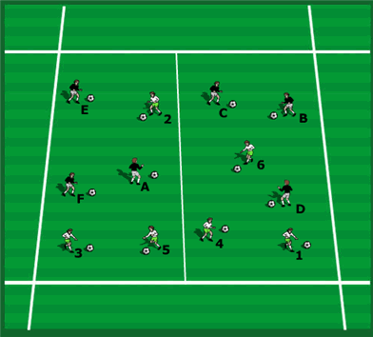
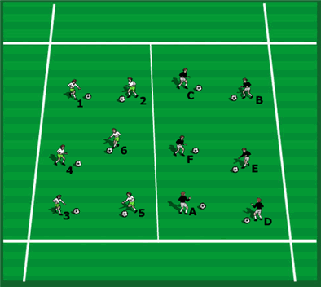
Advanced Warm up: Improving basic dribbling and awareness with lots of touches in possession of the ball
Four areas of Awareness:
1. “On the Ball” Awareness before receiving the ball,
2. “On the Ball” awareness as the player receives it and moves it on quickly using one or two touches only
3. “On the Ball” awareness if the player maintains possession of the ball using several touches; and:
4. “Off the Ball” awareness in terms of their positioning of players supporting the player On the Ball.
2
1. Coaching Points
a) Awareness of where other players are whilst maintaining possession of the ball ensuring players are looking around away from their own ball b) Dribbling and Turning c) Shielding d) Anaerobic Fitness work.
2. Moving around with the ball, staying in space with your own team to begin then players mixing in with each other. Stop and check positions. Check how spread-out players are, discuss the implications of being in possession of the ball in a game and making it hard for the opposition to mark you by using as much width and length as possible. Therefore, the players must use the spaces as effectively as possible.
Principles of Dribbling
1. Initial Movement: In a straight line at a slower speed.
2. Deception: Unbalance the opponent.
3. Accelerate: Into space using change of pace
4. Space behind opponent: pass the ball past defender and run.
5. Restricted space behind: dribble past defender (in slow, out quick).
1
6. Commands a) Turn (checking that no one is behind them first with a look over the shoulder then a turn if the space behind is free) Doing different turns they are good at. b) Out (they run outside the nearest line and check back in always looking to over the shoulder to see where other players are, so they do not run into them. c) Switch (changing soccer balls and continuing dribbling) d) Dribble (using a dribbling skill they are good at in a tight area) e) Right foot only (inside and out) This is more difficult so they will tend to look at the ball but remind them to look up when and where they can f) Left Foot only (as above)
g) Quick (change pace and move more quickly for a few seconds but with the ball under control) h) Number (coach will hold their hand up with several fingers indicated, the players must shout the number immediately by looking up and observing but also keeping control of the ball).

Slide 4
Criss-cross dribble
Dribble
Left
Criss-cross dribble a. Set this up before you start the exercise.
b. Set the grid up like the diagram.
Players are spaced evenly around the square.
c. On the commend the players on the right and lefthand side dribble across the grid trying not to bump into each other. They need to go around the disc and finish up where they started.
d. Next have the top and bottom groups go. Make a game of it they must go back and forth so many times, whoever does wins.
e. Eventually you want everyone going at the same time both Right and Left and Top and Bottom.
Top
Bottom
Right

Slide 5
1 v 1 Dribbling Challenge
Dribble
1 v 1 Challenge
a. A simple 1 v 1 red tries to score, blue tries the stop them. If blue wins the ball; then they try to score.
b. Encourages changing direction with two goals to play to.
c. OR; Blue plays to goal number 1 and Red to goal number 2
Run
1
2

Slide 6
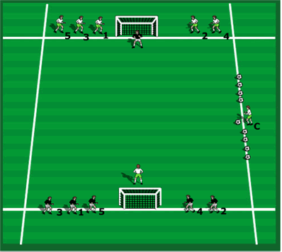
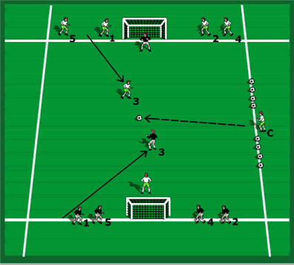
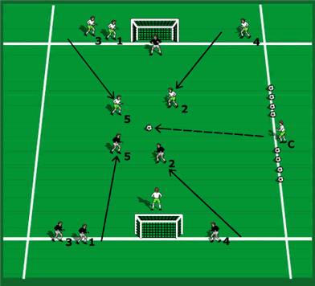
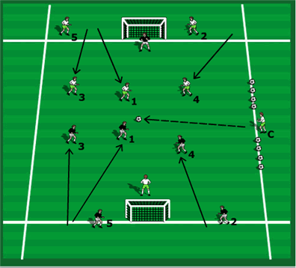
The Numbers game for quick finishing, incorporating dribbling, passing and finishing
Lots of dribbling opportunities in this game
1. Two teams and the coach calls a number or numbers to create two teams who play against each other. 2. The ball is played into the playing area, and it is the first team to get there who gets possession and attacks. the defending team must win it back to try to score. keep the score to make it competitive for the players. 3. Vary the numbers who go into the playing area. you can add them as you go e.g. do 1 v 1 then bring in another two players each team to go 3 v 3 as the game is developing. 4. As the numbers are called the teams must form a shape quickly. it can be 1 v 1 then 2 v 2 making combination plays, then a 3 v 3 and so on.
When defending, the triangle is smaller (shorter and tighter) than the attacking triangle (wider and longer).
Players love this game.

Slide 7
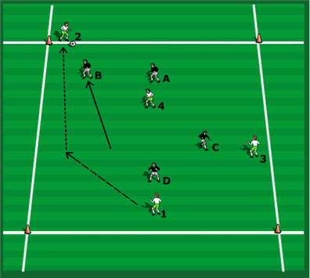
Always a Scrimmage
Let them play free of instruction
A 4 v 4 DRIBBLING GAME
We are encouraging players to make quick observations and quick decisions often resulting in a player passing the ball early to avoid being caught in possession it also helps players who are good at dribbling by enabling them to identify situations in advance to allow them to get in a good position to take a player on in a 1 v 1 situation. This could include opening the body up to receive and face up to an opponent, seeing the immediate opponent has no cover on so you can attack 1 v 1, seeing where the defender is early and identifying the best side to attack, seeing you have no support so must attack 1 v 1 etc.
It could be any game size depending on your player numbers.

Slide 8
Grades Seven to Nine
A North Star F.C. Training Plan for Recreational Soccer (Week Two)

Slide 9
Week 2: Passing, Control and Movement
Warm- up / Foundations
Warm up: Incorporating lots of control situations with the body and passing. 10 mins
a) Controlling the ball and passing
Square passing- then Diagonal passing
a) Set up like the diagram- divide the players into 2 equal groups. If you have more then 8 players, you simply add a disc and
make a hexagon.
b) Players must pass around the square – work on them receiving the ball across their body- opening their
hips.
c) Switch to diagonal passing. 15 min
Water break 5 Min
3. Target Game
a. 2 teams- instead of 2 / 4 goals you have a target player.
b. Once the team passes to that target player, they must go a different target player.
c. When the target player receives the ball; they dribble in and the person that passed them the ball takes their spot. 15 Min
4. Scrimmage- The 6-goal game developing control, passing and movement. 15 min

Slide 10
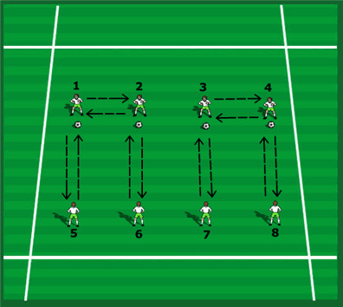
Warm up: Incorporating lots of control situations with the body and passing
Controlling techniques in two’s
f) Throw to both feet alternatively so they must control and pass with both feet. g) Throw and control with various parts of the body and volley the ball back. h) Combinations, chest, thigh, then pass one touch on the half volley. i) Throw to the ground, one bounce to the player who half volleys it back on the next bounce into their teammate's hands, softly and under control.
4. Use your imagination to practice other techniques, vary the distances between the players and so on.
1. Working in pairs, once the task has been performed have the end players switch with each other, (1) and (2) switch for example.
2. Servers stay in the same position and do 10 each then change.
3. Techniques to practice can be: a) Throw to feet to control in one touch and pass back (right and left) b) Throw to chest to chest down and pass back one touch on the half volley c) Throw to thigh to control and pass back one touch on the half volley d) Throw to head to head straight back (defensive or attacking headers) e) Throw to head to cushion down and pass back on the half volley one touch

Slide 11
Square Passing
Pass
Square Passing
a) Set up the field as shown. Set up in two equal teams.
b) If more than 8 players simply add a cone and form a hexagon.
c) Players must pass the ball around the square.
d) Work on them receiving the ball ACROSS their body – opening their hips.
e) Time 5-10 minutes.
C

Slide 12
Diagonal Passing Development
Pass
Diagonal Passing
a) Set up the field as shown. Set up in two equal teams.
b) Players set up as a diamond and use the cones as a reference to move to when needed
c) This can open a passing lane.
d) Work on them receiving the ball ACROSS their body – opening their hips to change direction if needed.
e) Time 5-10 minutes.
f) Introduce a defender.
C

Slide 13
Target Game
/ 4
Target Game a. 2 teams- You have a target player. b. Once the team passes to that target player, they must go to a different target player. c. When the target player receives the ball; they dribble in and the person that passed them the ball takes their place.
Lots of control and passing and movement opportunities to practice them.

Slide 14
Always a Scrimmage
Let them play free of instruction
Six Goal Scrimmage
Three goals for each team to score in. No coaching just let them play and have fun. 3 spread out goals encourages switching play.
Lots of control and passing and movement opportunities to practice them.

Slide 15
Grades Seven to Nine
A North Star F.C. Training Plan for Recreational Soccer (Week Three)

Slide 16
Week 3: Introducing basic Rondos to our training model
Rondos are great for developing simple ideas within a small area to develop consistent passing and movement ideas
Warm- up / Foundations
Square passing- then Diagonal passing Rondos
a) The theme of the day is developing Rondo ideas so we can start with it as the warmup.
Set up like the diagram- divide the players into 2 equal groups. If you have more then 8 players, you simply add a disc and make a hexagon as shown in the diagram.
c) Players must pass around the square – work on them receiving the ball across their body- opening their hips.
d) Switch to diagonal passing. 15 min
2. Sliding Rondos: 7 players: 5 v 2. Great for scanning the area. 10 mins
a) Very fast tempo playing ONE or TWO touches where they can. We must play into the central neutral pivot player as often as possible.
3. Teaching Circle Rondos Incorporating Combination Actions
An easy way to develop passing, running with the ball and passing and support ideas.
Next make it competitive developing 1 v 1 and 2 v 2 situations. 15 min
Water Break 5 Mins
Scrimmage: An attacking and defending 2 v 2 Rondo game challenging the mindset and mental transition of the players
Maintaining the Rondo theme throughout finishing with a fun competitive rondo testing attacking and defending principle of play. 15 Mins

Slide 17
Warmup
Square Passing
Pass
Square Passing
a) Set up the field as shown. Set up in two equal teams.
b) If more than 8 players simply add a cone and form a hexagon.
c) Players must pass the ball around the square.
d) Work on them receiving the ball ACROSS their body – opening their hips.
e) Time 5-10 minutes.
C

Slide 18
Warmup
Diagonal Passing Development
Pass
Diagonal Passing
a) Set up the field as shown. Set up in two equal teams.
b) Players set up as a diamond and use the cones as a reference to move to when needed
c) This can open a passing lane.
d) Work on them receiving the ball ACROSS their body – opening their hips to change direction if needed.
e) Time 5-10 minutes.
f) Introduce a defender.
C

Slide 19
Sliding Rondos: 7 Players: 5 v 2 NO rotational movement outside to inside initially. Great for SCANNING
6 points of observation for players:
1. Teammates positions,
2. Defenders (cones) positions;
3. Where Spaces are,
4. The position of who I'm receiving from,
5. The position of who I'm passing to,
6. Where the other balls are which will force each player to consistently scan the field.
Defending players stay in for one minute then change with outside players. Very fast tempo playing ONE or TWO touches where they can. We must play into the central neutral pivot player as often as possible. Do this one with no movement or rotation of players to begin.
A
E
A
E
A
B
1
1
1
B
E
B
2
2
2
C
D
C
D
C
D

Slide 20
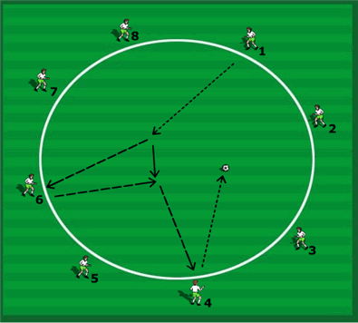
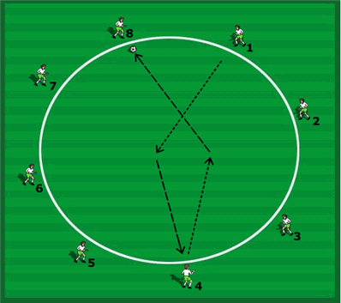
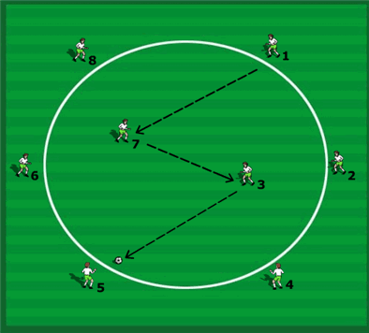
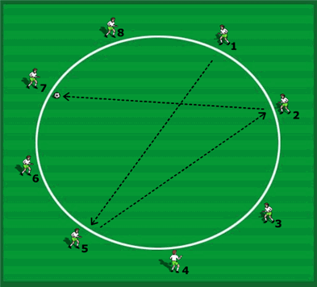
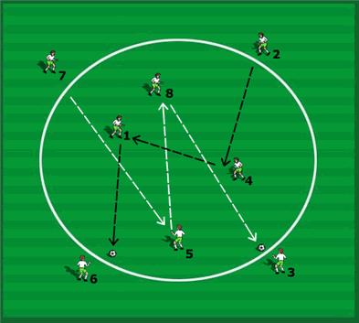
Teaching Circle Rondos Incorporating Combination Actions
Passing and Support
1. You can divide the teams into two and have half the players working and half resting. Work a set time then change the players. Here the players are running with the ball then passing and then will get it back to go somewhere else to another player to work with.
2. Change the emphasis on the movement, running with the ball then during the run the player must change direction with a clever dribble or turn, or they pass to an outside player, do an overlap around them and get the ball back, play a give and go with them and do a turn when they receive it back.
3. Many ways to develop this idea to get lots of touches on the ball, practicing running with the ball, receiving and turning with the ball and dribbling with the ball, combination plays, give and go’s, overlap runs and so on. The coach can use his or her imagination to make this work.
Run and Pass
So easy to teach this at all levels and ages of play
3
1
1. To increase the players awareness instincts ask them to call the name of the player out who they will be passing to, before they receive the ball.
This ensures they look to see who is free before they receive the ball, so they know in advance who is free to receive. 2. One ball, (1) runs and passes to (4) and takes
their place. (4) Takes the ball, runs and passes to
(8) and so on.
Progression – introduce two, then three, then four balls all going at the same time. “Awareness” of where each player is running is needed
here so they don’t collide and where potential free players to receive are “before” you make the run and pass.
Coaching Points:
a) Good communication between the players.
b) Quality of the pass (timing, accuracy and weight).
c) Good first touch by the receiver.
d) Progression – Passer becomes a passive defender who puts the receiver under pressure.
The receiver must move the ball away at an angle from the pressure on their first touch.
4
Running with the Ball
1. As the ball is going to (7) he or she have already looked to see where (3) is to pass to. (3) Has already got into a support position to be ready to help (7) and at the same time is viewing the field to see who is available to
receive a pass on the outside.
2. As the ball travels to (3) ask them to call the name of the player they intend to pass to, before the ball gets to their feet. To do this they need to look at (7) as the ball arrives, look to see who is free then look back to see the ball coming.
3. (7) moves to an angled support position to receive
the pass from (1). (3) Makes an angle off (7) to
receive the ball then passes to (5).
Coaching Points:
a) Body shape when receiving;
b) Quality of pass (weight, timing and accuracy)
c) Support angles
d) Good first touch.
Progression: Two pairs playing at the same time.
a) Three players working together in the
middle b) Two pairs working together in the middle.
2
c) Run in a straight line, the quickest route.
d) Running Style, use the front foot to control the ball using the laces.
B) Decision: Where is the player taking the ball? In this case to (5) but (5) must try to decide as the
ball is coming not after he or she has it. Identify who is free.
C) Communication: Call the name of the player you are running the ball to.
D) Timing of take-over: (1) does not pass the ball to (5) but allows (5) to take it using the momentum of the ball. (5) must use a good first touch to get the ball out of the feet.
5
6
A) Running with the ball technique -
Head Up – look forward, observing options “before”
receiving the ball using the awareness training.
b) Good first touch out of feet, 2-3 touches maximum, not dribbling.

Slide 21
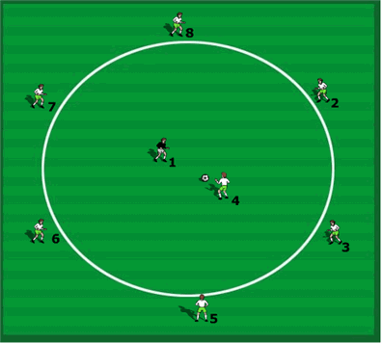
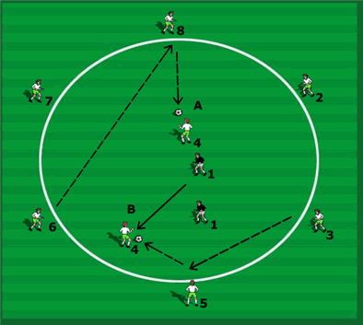
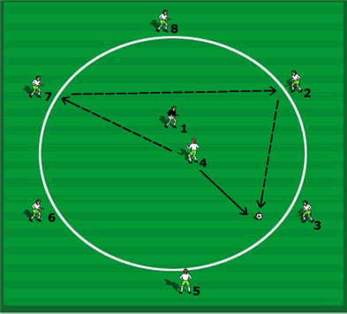
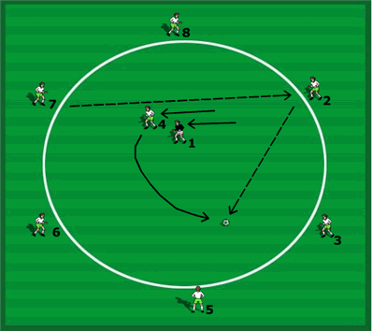
Theme: Teaching Circle Rondos now Incorporating “Competitive” Action
One v One
Introduce Opponents
1
1. 1 v 1’s – This is now possession play (keep ball) in the middle to start, outside players two touch but must release it quickly to keep the pressure on inside the circle. This is highly intensive work. Rotate players. Inside players as many touches as they like, practicing dribbling skills in 1 v 1 situations, passing and movement off the ball working combinations with teammates.
2. Inside players cannot tackle outside players but can intercept passes from them. Outside players can move side to side to improve their support angles. Emphasize passing to both space and to feet.
3. This is technically a 7 v 1 in favor of the player in possession.
1. Avoid players closing their own space down by getting too close to the player on the ball. At figure 1, (4) has got too close but also gone in too straight so cannot view the full field nor see where the defender is.
2. Correct movement would be off at an angle to receive facing forward and inside if possible, seeing the whole field. Figure 2 shows this. If the defender blocks the pass to (4) then the passing channel is open for (5) to pass elsewhere and (4) will work their position off the next pass.
3. Try to receive the ball facing inside not outside the circle so you can see the full area and all the players if possible. An open body stance will help this even receiving “side-on” helps. In figure A (4) can see (8) but little else of the other players or the field, in figure B, (4) can see most of the players and most of the field when receiving the ball or moving to receive the next pass if (3) passes it elsewhere.
3
2
1. Players can pass the ball around the outside until a pass is on to an inside player. You can restrict the number of continuous outside passes as the main work has to be done by the inside players so keeping them involved.
2. Players on the outside identify who they are passing to as the ball is coming to them. They can call a player's name to pass to “before” they get it so the inside player in possession knows which player to work off next to receive the ball from again. Or as the ball is coming to (7), player (2) may call and ask for the next pass to make (7) aware that this player is open and available, good communication is the key to this.
4
1. Here (4) comes to receive a pass, (1) is marking tightly. (7) Can pass the ball to the opposite side of (4) away from the side (1) is defending.
2. (7) can also put a little more weight on the pass, (4) lets it run across his or her body with a feint to fool (1), it runs to (2) who then can lay the ball off back to (40 who has turned away from (10 to get free to receive the next pass.
3. This movement creates space behind for (4) to run into off the next pass. (4) must be aware of the position of (2) “before” the pass to let it run to them. (2) Has to be ready to receive and expect the ball from (7).
4. A one or two touch pass from (2) into space for (4) ensures the movement and passing is rapid and gives the defender (1) less time to react.
5. Try to get faced up to the defender when you receive the ball and not play with your back to them this gives the player on the ball the advantage.
3. Here (4) passes to (7), who, as the ball is traveling calls out (2)’s name. This is a cue for (4) to then change position to receive the next pass from (2) early and in space. One or two touch play on the outside will mean this is quick passing and it will help (4) get possession again early and in space away from defender (1), who hopefully has been left flat footed.

Slide 22
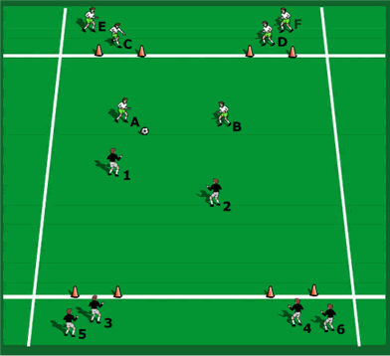
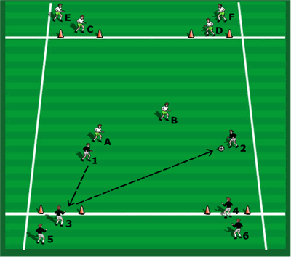
A Rondo Scrimmage
An attacking and defending 2 v 2 Rondo game challenging the mindset and mental transition of the players
Equate the 2 player / 2 goal set up to the two central midfield players or two center backs or two Strikers working together
1
1. A 2 v 2 game going to 4 goals. The team who scores stays on and must quickly defend the 2 new players coming in (one from each goal that the opposition defends).
2. Instant transition with the same ball that the opponents scored with, here (3) and (4) are positioned to immediately bring the ball the opponents may score with out to attack. The other two players (1) and (2) must get off the field ASAP.
3. Introduce a target player (can be coaches or players). Now it can be a 3 v 2 effectively. Players can use the target to play give and goes with each other or with their immediate teammates.
4. The 1st thought of the player on the ball must be “Can I score?”
5. The 1st thought of the 1st defender is can I stop them scoring, win possession immediately, and score myself or through a combination with my teammate..
6. First team to 10 goals wins, keeping the competitive element.
7. If the ball goes out of play the coach can provide another one to keep things going quickly.
(1) And (2) should view the opponent’s goals / players as teammates of theirs whom they are trying to pass to
Coaching Points Attacking:
a) Quick Break and counterattack
b) Switching the point of attack if another goal is more open
c) Quick one and two touch passing
d) Positioning to open passing lanes and getting between defenders to pass the ball in early
e) Creating 2 v 1 situations from a 2 v 2 set up and setting up a give and go.
Develop:
1. Allow back passes to the players in their own goal so they can support the two (or three or four) attacking players on the ball.
2. Allow them only one touch so they must pass it quickly, make a quick decision and players receiving all need to get open to help them.
3. Vary the number of touches on the ball depending on the age and level of the players and their ability to perform.
Coaching Points Defending:
a) Instant pressure as possession changes (transition after scoring going from being an attacker to being a defender)
b) Regaining possession at the front with a scoring reward
c) Getting in front of the passing lanes to prevent the quick pass into the goal.
d) Working together with pressure and support, the support player supporting the first defender, stepping across and covering the passing lane to the second goal and keeping an eye on the 2nd attacker.
Transition Coaching Points:
Immediately the team that has been in possession of the ball and has scored then they must switch on mentally to being defenders and high pressuring the new attacking team to try to win the ball back and score again.
2

Slide 23
Grades Seven to Nine
A North Star F.C. Training Plan for Recreational Soccer (Week Four)

Slide 24
Week 4: Principles of Defending
Warm up- Defending foundations, etc.
1. Individual Shadow Defending
a) Players are sideways on running backwards to the other line changing sides in defensive mode.
Now 2 players together, one attacker one defender. Shadow defending running backwards checking side to side to counter the attackers’ movements. 5-10 mins
individual and combined defending – Closing down: Defending in 1 v 1; 2 v 1 and 2 v 2 situations
a) Teaching the principles of individual and combined defending. 20 mins
3. Water Break 5 Min
A small sided game situation with a defensive overload
a) Making it more team orientated but introducing it with the overload to gain early success and confidence. 10 mins
5. A Scrimmage: Teaching a Defensive Pressurizing game to win the ball in 1 v 1 situations a) Teaching players better 1 v 1 defending plus how to defend as a team. 15 Mins

Slide 25
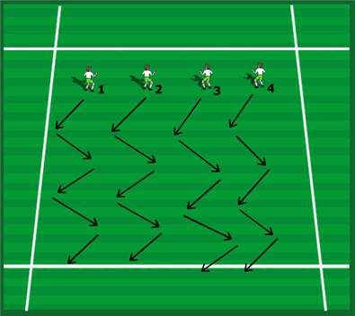
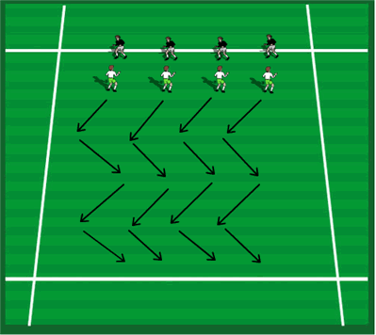
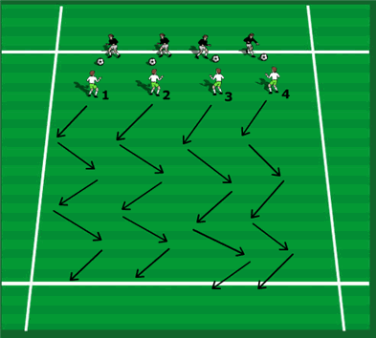
Warmup
Practicing Individual Shadow Defending
1
2
3
1. Players are sideways on running backwards to other line changing sides in defensive mode. Increase pace.
2. Shadow heading and running back on coach’s command.
3. In two’s, one running moving side to side, the other running backwards changing sideways on stance checking opponents run.
4. A ball between two working as above, working back and forward, defender shadowing the ball not winning possession.
5. Practice feinting to tackle with your front foot, forcing attacker to protect the

Slide 26
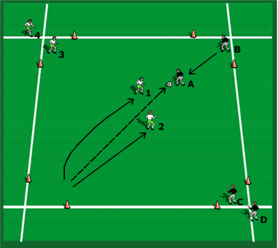
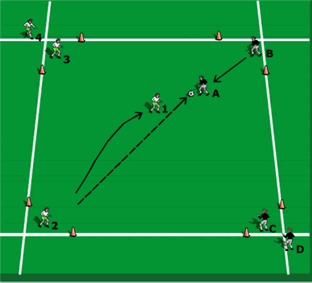
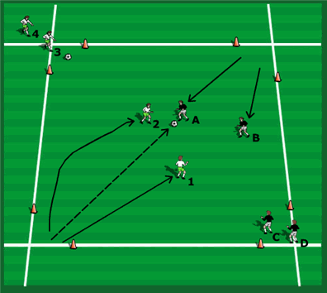
How to defend effectively:
Coaching points of individual defending – Closing down.
1. Travel as fast as possible as the ball travels to close opponent.
2. Close the opponent down with a curved run forcing the player the way you want them to go (if you have time to do so).
3. Slow down the last few yards, get balanced, bend knees, sideways on stance forcing the play your way, and slow the attacker up (making play predictable).
4. Feint to tackle – use your front foot this forces the opponent to protect the ball and ultimately look down at the ball and away from you the defender (also prevents awareness of where support players are in a game situation). Try to steal with front foot.
5. Watch the ball not the player so you aren’t thrown by body movement.
6. Stay on your feet and be patient, your chance will come to win the ball if you go to ground you give the initiative to the attacker.
Defending with a 2 v 1 advantage
pressure and support
2
1. (1) passes to (A), (B) closes and stops (A) from turning and scoring. Previous coaching points but also gets touch tight to attacker. You can judge the distance by touching the back of the player.
2. Move with the player to maintain the same distances between you, if the attacking player goes back away from your goal, keep the same spacing between you by moving with them, not allowing them to turn and face you by increasing the distances between you both. If the distance between you are too far away the attacker can and will turn and face up to you creating a 1 v 1 situation which is a great advantage to the attacker. Too close and the attacker can spin off you are using the feel of your body as momentum to spin away quickly into space behind you.
Defending in a 1 v 1 situation
1
7. Think about the way you want to player to go, it can be onto your opponent’s weakest foot or to the side you are strongest and most confident to tackle on. It can depend on the side there is less space to work in for the attacker to restrict their movement and options and to make play predictable.
8. Encourage the players to not only win the ball but also to maintain possession of it if they can. In this session they can win it and try to score into the other goal as a reward for gaining possession. In this instance both players will get a chance to practice defending in the same sequence.
Defending in a 2 v 2 situation
pressure and support
3
1. Develop: 2 v 2 with (B) joining in. In a 2 v 2 show the “piston effect” of support movements as the ball travels. Also consider that the closest player can close the ball as it travels from player to player (discussed later).
2. (2) closes (A) down and shows inside to the support player. (1) Supports at a 45-degree angle but is also screening (B). In the 2 v 1 situation (1) only had to think about supporting (2) but now there are two things to consider; supporting (2) and screening the position and movement of (B).
Session Plan
1. Receiver (A) tries to score through defender (1)’s goal. Work both sides and alternate numbered players and lettered players.
2. All players get the chance to attack or defend.
3. Encourage and praise good defending.
4. Correct the faults.
5. Step in and demonstrate to show the players what is needed if required, demonstration is better than explanation.

Slide 27
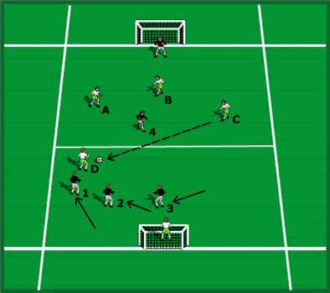
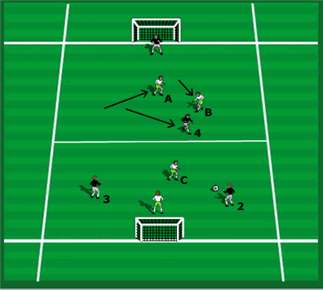
Three v one in each half
A Small Sided Game Situation
Start with a 3 v 1 in each half to give a big defensive overload to get success to build each defender's confidence
1. The closest player picks the attacker up as the three defenders are marking zones.
2. Pressing player (1) shows an attacker (D) inside to the supporting players and not outside where it could become a 1 v 1.
More difficult now with only 2 defenders in each half against one attacker
Two v one in each half
1. In Two’s: Working on the pressing player (1) and the supporting player (2) together now using communication from the support player asking the pressing player to show the opponent one way or the other (though the coach dictates in this clinic for ease of organization).
2. Each time they change a set of cones the pressing and support players change positions, call “switch”, the support player (2) becoming the pressing player the next time and so on.
3. Working on angle, distance, and communication between the two players
1. 2 v 1 in each half; players need to learn when to decide to pass the sole striker on as they change zones.
2. Here we see the adjustment of the players when (4) (who was marked by A) moves across the field and is passed on to (B) who closes (4) and (A) drops back into a support position behind.
3. Ensure the players talk to each other as this happens so there is good communication between them.

Slide 28
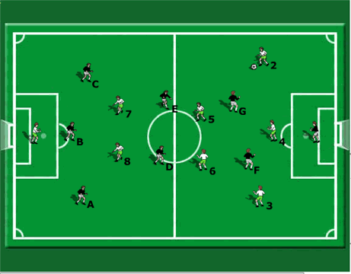
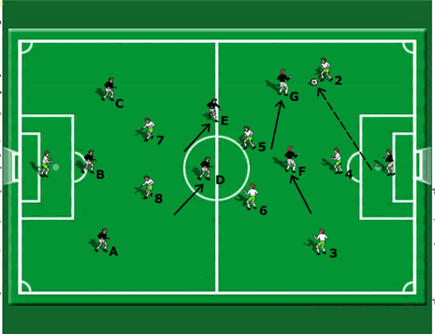
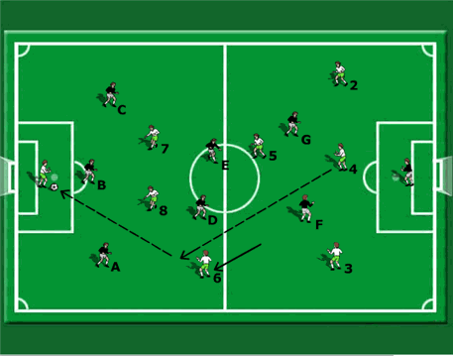
A defending based Scrimmage
Teaching a Defensive Pressurizing game to win the ball in 1 v 1 situations
1
A Brilliant game to teach 1 v 1 pressing at any level / And its FUN with a Capital F / First team to 10 goals wins.
The game is designed to work on pressurizing the player on the ball, prevent a forward pass and ultimately win the ball. Closest player must pressure the ball. To score, a player can make a pass from anywhere into the keeper’s hands. The ball can be played in the air to the target’s hands (to practice quality long distance lofted passes) or on the ground to feet (driven passes). All over the field players must work hard to close people on the ball down quickly.
Develop – A) As a reward when a team scores a goal, they keep possession; so, they play to the opposite goal to score. Previously they played to the same goal, and the opposition got the ball when they scored.
Show by high pressure as a team how defenders can win the ball back early and close to the opponent’s goal to score. Need to push up from the back to start this.
Teams almost subconsciously defensively press up together as a team to win the ball as each attacking player is looking to receive the ball from the keeper to begin.
2
1. Coaching Points:
a) Quick Pressure on the ball b) 2nd defender supplying close Support for first defender
c) Deeper Cover from third defender
d) Recovery runs from players in front of the ball
e) Regain possession
2. Here the job of player (G) is to pressure the ball as quickly as possible to win it back. (F) supports across, (G) shows the player on the ball inside towards (F) and between them they try to win the ball back quickly. (E) Offers a balanced covering deeper position behind them. 3. Players cannot go into the keeper’s area.
3
Go to MAN –MARKING so now in possession; players must get free, and defenders must work hard to stop them scoring.
So, all players now in 1 v 1 SITUATIONS all around the field. Now the real FUN begins.
1. For example, (6) and (D) mark each other or try to get free of each other depending on who has possession of the ball.
Here (6) gets free of defender (D) and chips the ball into the keeper to score a goal. Once this has happened a few times players get the idea they need to work hard to close quickly opponents on the ball. 2. This game improves the urgency with which players need to close opponents down as they are so easily punished in this game if they don’t.
3. If the defending player is beaten and their attacking counterpart scores a goal then that player must do 5 pushups.

Slide 29
Grades Seven to Nine
A North Star F.C. Training Plan for Recreational Soccer (Week Five)

Slide 30
Week 5: Shooting and Finishing
Warmup / Foundations
1. Fast Footwork; co-ordination and speed work
a) Getting the feet and body balanced and prepared for the first touch. b) Players must be light on their feet to be able to change their stride patterns, change direction and so on. 10 min
2. Practicing and improving shooting on goal using simple shooting ideas
a) Gradual building up from passing to shooting. The Focus is on accuracy before power initially. 10 mins
b) Build the idea up now play in twos v twos.
3. 1 v 1 Fun Challenges: Simple 1 v 1 shooting and finishing ideas
Developing quick feet, head up approach and a calm finishing shot. 15 mins
4. Water Break 5 Mins
5. The Numbers Competitive Shooting Game
The players love this game its competitive and encourages lots of shots on goal. 10 mins
6. Power and distance shooting Game
a) Fit this in only if you have time. It can also serve as your last scrimmage game also. 15 mins
7. Scrimmage
a) A regular game or finish with previous game ideas for a scrimmage.

Slide 31
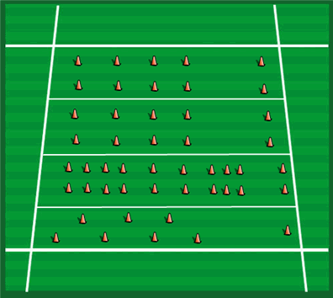
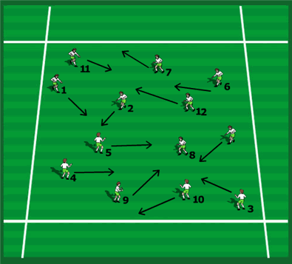
Warmup
Fast footwork warm up to help speed; co-ordination and balance.
Fast footwork; co-ordination and speed work:
All training is specific to match play. Our work is based upon developing a balance between ball handling and functional running and sprinting in combination with jumping, stopping, and turning.
Quick feet, light feet, changing stride length exercises (short and sharp the best) will be particularly important.
For getting your feet ready to shoot at goal, perhaps with very little time to adjust this exercise is perfect to develop this ability for finishing.
Coaching Points in Shooting:
a) Positive Attitude to shoot, quick shooting where needed. b) Receive on the Half Turn or facing forward, if possible (create space for yourself), take the chance. c) Accuracy and Power (accuracy first). Be composed. d) Shooting High or Low (low best because it’s more difficult for the keeper). e) Selection of Shot (driven, chip, side foot, swerve etc.). You can use defenders to shoot around for placement. Check the keepers’ position (if you have time!) f) Near Post or Far Post (can depend on the keepers' position, also if you shot and miss at the near post the ball is out of play, if shooting at the far post and it’s missing, the keeper may palm it to a player following up, a striker may intercept it on its way and score, (it may hit a defender and go in off them). g) Rebounds (follow all shots in).
Players can move anywhere. This involves them using anticipation, decision making, reaction and perception and well as co-ordination and fast feet to find space to move without bumping into people.
Peripheral vision development is starting to be introduced without the ball.
Usual coach commands can be start and stop so they are practicing acceleration, deceleration, and lateral movement all in one exercise.
You can also use the commands turn, jump (for a header) check, sit down and so on for which they must do a short sprint after the command then stop on the call stop. All these are specific movements in the game.

Slide 32
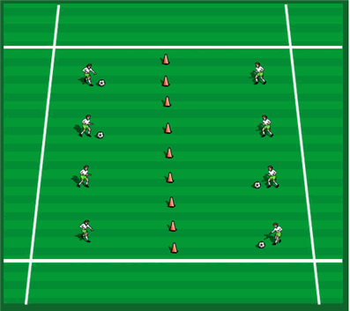
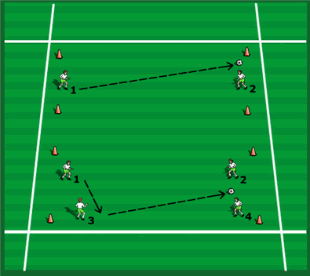
Practicing and improving shooting on goal using simple shooting ideas
Developing good technique for shooting at a central goal
As always with a ball each and stretching.
Initially Passing through the central goals to each other building up the pace and accuracy.
1. In two’s shooting through the coned empty central goals to each other. We are looking for accuracy and good technique. Have the players count the number of goals they score. Have a few rounds adding up scores each time.
2. If you have the upright cones have them shooting to knock over the cones. Do it alternately per player on each side and count which team knocks the most cones over (competitive). Ensure players are all organized properly behind an end line, so they all shoot from the same distance.
A Simple shooting practice now with goals.
Players are in two’s 10 to 20 yards apart, distance depending on the age group you are working with. Each has a goal to defend, and they must score past each other. Keep it to two or three touches per shot. Focus on the technique of striking the ball and explain and demonstrate this to the players.
1. Develop: Have them shoot with their stronger foot for a time then have them practice with their weaker foot too.
2. Conditions: Work on side foot shooting, instep shooting, swerving the ball with the inside and outside of the foot etc.
3. Competitive: Keep the score.
4. Develop: Have two v two games so some passing, and shooting is developed encourage a one touch shot from a well weighted pass from their teammates as shown.

Slide 33
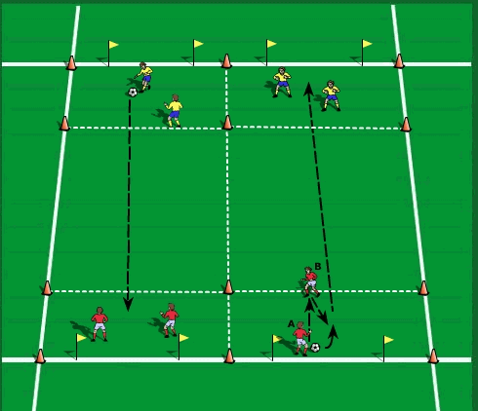
Build the idea up now play in twos v two’s
1. Players (A) and (B) pass the ball around inside the coned area.
2. After completing 3-4 passes one of the players must run to the 5-yard line to receive a pass from his partner.
3. In the above diagram player (B) runs to the line. Player (A) passes the ball to (B).
4. Player (B) must lay the ball off to (A) with one touch for a shot at the opponent’s goal.
5. The sequence is repeated by the team (yellow) at the opposite end of the grid. Players may use their hands to save shots.
6. Players must score as many goals as possible in a designated period.
Progression: All passing must be one touch. All shots on goal must be one touch no preparation touch.
Coaching Points: Strike the ball with the laces. Strike through the ball – land on the kicking foot. Passing must be sharp and accurate. The layoff must be at a slight angle.
Accuracy before power on all shots
Combining with a teammate to create a shooting opportunity.
10 x 25-yard grid. Four players per grid with one ball Flags are used to create a goal at each end of the grid. Players work in pairs and are positioned at opposite ends of the grid as shown. Cones are placed to create a 5x10 yard area on both sides of the grid. Repeat set up to accommodate the entire team.

Slide 34
Simple 1 v 1 shooting and finishing ideas
1
The players love this one.
The coach serves the ball between or either side of the two players.
Who can react first to get to the ball and score?
Players face forward so cannot see the delivery and must REACT to the pass or throw.
Here, (1) is first to the ball against (2) to get the shot in on the run.
Encourage running forward at pace and not checking back to give the defender a second chance.
Vary the players stances; for example; sometimes they must get up off the ground first.
Or facing towards the coach then must TURN to chase the ball down to shoot.
Build it up 2 v 2 and so on.
Pass, chase from behind and finish (3 yards apart so they will get a chance to shoot)
1
3
8
9
5
3
1
6
C
K
7
6
4
2
K
4
5
2
3
2
Pass and finish (3 yards apart so they will get a chance to shoot)
4
Pass and finish no pressure first. Pressure From in front, then player follows their pass to pressure.
Try to get a fast shot in before they can close you.
4
8
9
3
6
2
7
8
K
K
4
5
(2) Passes to (8). (8) shoots. (5) to (9), who shoots.
(2) Runs to the cone for the next shot as does (5).
Rotation so everyone is shooting.
9
5
2
3
6
7

Slide 35
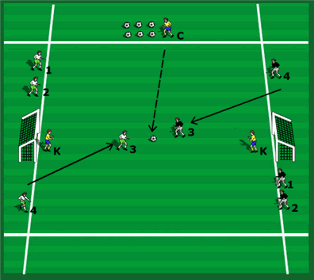
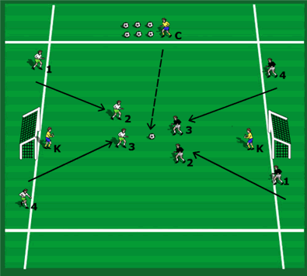
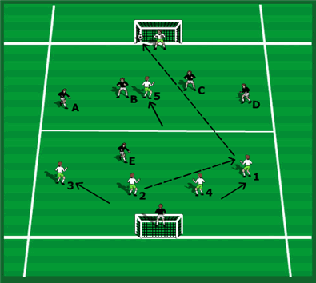
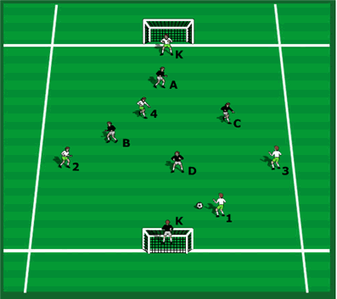
The Numbers Competitive Shooting Game
SO MUCH FUN. Number players off and have a competitive game with two teams. Calling numbers out to create 1 v 1’s, 2 v 2’s, 3 v 3’s etc.
Make it competitive by keeping score, the coach serves the ball calling the number (have plenty of balls handy so it’s continuous).
The first team to score 10 goals in the winner.
Power and Distance Shooting Game
Finishing with a scrimmage
1. Long Range Power Shooting Practice: Encourage players to shoot whenever possible. They can only shoot from their own half of the field; players stay in the same half. The sole forward can work for rebounds. They can also be used to set up shots for support players.
2. Coaching Points:
a) Spread Out as a team to create space to receive and shoot.
b) Decision - Pass the ball until a player is in a good position to shoot at goal. Take the shot.
c) Technique – A good first touch to set the shot up (or first time shot).
d) Accuracy and Power (in this order) and Shot Selection (driven, swerved etc).
High / Low, Near / Far Post Shots. (Low far post is best depending on the keeper’s position).
Rebounds – Off the keeper, a defender or the goal. Be alert and get into position.
3. You are looking for player’s attitude to shoot, hitting the target, correct selection and positioning of shot, anticipation positions for rebounds from the forwards.

Slide 36
Grades Seven to Nine
A North Star F.C. Training Plan for Recreational Soccer (Week Six)

Slide 37
Week 6: Developing shooting and finishing in and around the box
We can now progress to taking our shooting exercises into a real game situation focused in and around the box.
This is a very competitive game the players will love playing. It can take up the whole session for you there are so many ideas to get in.
This can take up the whole session.
Warmup / Foundations
1. Fast Footwork; co-ordination and speed work
a) Getting the feet and body balanced and prepared for the first touch. b) Players must be light on their feet to be able to change their stride patterns, change direction and so on. 5 mins
2. Combination and Link up play, give and go ideas and runs off the ball
a) Different challenges to players to enable them to keep improving basic ideas 10 mins
Transition Attacking and Defending
Working on both strategies of the game 15 Mins
4. Water Break 5 Mins
5. Crossing and Finishing as an exercise
a) Short and sharp crossing and finishing in tight areas, great practice for the real games. 10 mins
6. Scrimmage
a) A regular game or continue with this set up if you need more time to get all the ideas across with the players. 15 Mins

Slide 38
Warmup
Fast footwork warm up to help speed; co-ordination and balance.
Fast footwork; co-ordination and speed work:
All training is specific to match play. Our work is based upon developing a balance between ball handling and functional running and sprinting in combination with jumping, stopping, and turning.
Quick feet, light feet, changing stride length exercises (short and sharp the best) will be particularly important.
For getting your feet ready to shoot at goal, perhaps with very little time to adjust this exercise is perfect to develop this ability for finishing.
Coaching Points in Shooting:
a) Positive Attitude to shoot, quick shooting where needed. b) Receive on the Half Turn or facing forward, if possible (create space for yourself), take the chance. c) Accuracy and Power (accuracy first). Be composed. d) Shooting High or Low (low best because it’s more difficult for the keeper). e) Selection of Shot (driven, chip, side foot, swerve etc.). You can use defenders to shoot around for placement. Check the keepers’ position (if you have time!) f) Near Post or Far Post (can depend on the keepers' position, also if you shot and miss at the near post the ball is out of play, if shooting at the far post and it’s missing, the keeper may palm it to a player following up, a striker may intercept it on its way and score, (it may hit a defender and go in off them). g) Rebounds (follow all shots in).
Players can move anywhere. This involves them using anticipation, decision making, reaction and perception and well as co-ordination and fast feet to find space to move without bumping into people.
Peripheral vision development is starting to be introduced without the ball.
Usual coach commands can be start and stop so they are practicing acceleration, deceleration, and lateral movement all in one exercise.
You can also use the commands turn, jump (for a header) check, sit down and so on for which they must do a short sprint after the command then stop on the call stop. All these are specific movements in the game.

Slide 39
Developing team play
1. Three teams the outside team works with the inside attacking team. Great to teach both defending and attacking play.
2. First team to score 1 goal stays on; the losing team goes off as fast as possible. The outside team coming in now attack the team who just scored and are now defending so more fast transition mentality happening.
3. Keep the score for number of wins per team.
4. Transition game: Defending team wins the ball; they must pass to the outside team to then attack.
5. Teaches the mentality of transitional change.
6. Developing Quick Play in and around the box.
7. As soon as the team lose possession they must try to defend on the offside line and beyond, thus immediately pushing opponents away from the goal.
8. Using the set up through the “numbers” to suit how we set our teams up.
9. Offside rule applies.
The three team Transition Game: Quick Play in and around the box.
Progressing this right after our last session on shooting and finishing taking it into a game situation in and around the box.

Slide 40
Combination and Link Play
Third Man Run from (7)
3
Outside player (6) passes to inside attacking player (10).
(10) passes to (9) dropping off defender (C) to find a Little space..
An around the corner pass from (9).
(7) times the run between (B) and (D) to stay onside.
3
Creating Third Man Runs. Forward pass, support behind, pass back.
A Forward pass, support in front of the ball by (7); and timing of the run by (7) to stay onside.
(9) And (11) follow in to provide added attacking support..
11
A
11
A
6
6
C
9
C
9
K
10
B
K
10
B
8
8
7
7
D
D
2
2
Give and Go’s
Transition defending to attacking a)
Defender (B) wins the ball and MUST pass to an outside player to then attack the goal.
So (B) to (6) to (D) to attack.
Defending team now become the attacking team
Attacking team now drop into defensive positioning to become the defending team.
3
A give and go from (7) and (9), one of the best moves ever.
Short and Sharp and one touch quick play.
As previously stated the timing of the run behind is vital.
(9) Times the run perfectly to be onside when receiving the return give and go pass.
3
11
11
A
6
6
A
C
9
C
9
K
K
10
B
10
B
8
8
7
D
7
D
2
2

Slide 41
Transition defending to attacking b)
Transition defending to attacking c)
Defender (B) wins the ball and MUST pass to an outside player to then attack the goal.
So (B) to (6) to (D) to attack.
Defending team now become the attacking team.
Attacking team now drop into defensive positioning to become the defending team.
The keeper saves the ball and distributes it to either the defending team (now transitioning into attack) or directly to an outside player.
Here the pass or throw is to defender (D) who links with outside player (8) who changes the point of attack to (6).
3
3
A
11
A
11
6
C
6
9
9
C
B
K
K
10
B
10
8
7
8
7
D
D
2
2
Crossing and finishing
Crossing and finishing
3
Now using our outside players to get a cross in and find Good attacking positions to shoot or head on goal.
(9) Goes near post, (11) goes far post, (7) if time allows positions in behind (9) and (11) should the cross be more of a pullback.
Or (9) far post and (11) near post, crossover.
3
End Product.
Not showing defensive recovery for ease of display.
Showing the attacking players getting into position to receive the cross and hopefully score.
(11) Receives the cross and scores. It could alternatively be (9) who scores at the near post.
11
A
A
6
6
11
C
K
10
C
7
K
9
10
9
8
B
8
B
7
D
D
2
2

Slide 42
Grades Seven to Nine
A North Star F.C. Training Plan for Recreational Soccer (Week Seven)

Slide 43
Week 7: Teaching Awareness and Scanning
Warmup / Foundations
1. Fast Footwork; co-ordination and speed work
a) Getting the feet and body balanced and prepared for the first touch. b) Players must be light on their feet to be able to change their stride patterns, change direction and so on. 5 mins
2. Improving awareness with a ball each
Encouraging scanning the field as they move around the area
Develop the idea with only a few balls now passing and moving 5 mins
3. A two-team Set Up Identifying Options
Passing and moving freely in the area. Who is free to receive? 10 mins
Using a Non – Competitive NUMBERS “Game” with teams passing in sequence to improve awareness on and off the ball
10 mins
5. Using a Competitive NUMBERS “game” with teams passing in sequence to improve awareness on and off the ball
10 mins
6. Water Break 5 Mins
7. Scrimmage
a) A regular game or finish with previous game ideas for a scrimmage. Always emphasizing scanning and game awareness. 15 mins

Slide 44
Warmup
Fast footwork warm up to help speed; co-ordination and balance.
Fast footwork; co-ordination and speed work:
All training is specific to match play. Our work is based upon developing a balance between ball handling and functional running and sprinting in combination with jumping, stopping, and turning.
Quick feet, light feet, changing stride length exercises (short and sharp the best) will be particularly important.
For getting your feet ready to shoot at goal, perhaps with very little time to adjust this exercise is perfect to develop this ability for finishing.
Players can move anywhere. This involves them using anticipation, decision making, reaction and perception and well as co-ordination and fast feet to find space to move without bumping into people.
Peripheral vision development is starting to be introduced without the ball.
Usual coach commands can be start and stop so they are practicing acceleration, deceleration, and lateral movement all in one exercise.
You can also use the commands turn, jump (for a header) check, sit down and so on for which they must do a short sprint after the command then stop on the call stop. All these are specific movements in the game.

Slide 45
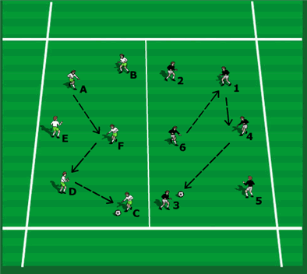
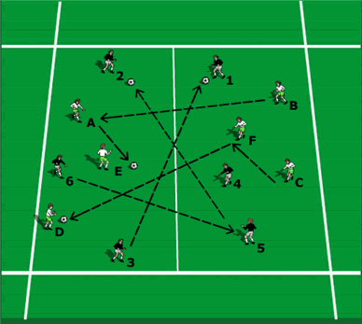
Improving awareness with a ball each
1. Moving around with the ball, staying in space. Stop and check positions. Check how spread-out players are, discuss the implications of being in possession of the ball in a game and making it hard for the opposition to mark you by using as much width and length as possible. Therefore, the players must use the spaces as effectively as possible.
2. Continue with dribbling but emphasize keeping the head up and not looking at the ball but looking around, in front, side to side and behind (for younger players equate it to a bird on a fence, that is, a bird on a fence just spends time looking around). The players can see the ball in their peripheral vision without looking at it directly.
3. Emphasize awareness of where other players are who are working in the same area by looking around; in front, to the side, and behind. You can include switching play by the coach calling “switch” where balls are stopped, and players must take someone else’s ball and continue dribbling. This determines who has quick awareness of where the free balls are.
Identifying levels of awareness
1. Start with one team only to simplify the process for the players as an easy introduction to the idea. Then divide them into two teams later once they are starting to master the idea.
2. Have the players stand still and pass the ball around the group. They must look before they receive the ball to see where they are passing to. Make it 2 touches then 1 touch.
3. To ensure they are looking have them call the name of the player they are passing to before they pass the ball. When they don’t call the name, you know they have not looked ahead of the ball.
4. Observe which players cannot do this and allow them 2 touches and more time and look to see how they improve with practice.
5. Develop – Have two teams and have them pass to opposite colors so the choices are halved, so the players must be even more aware of where they are passing to before they receive the ball.
6. Introduce 2 balls to the session then 3 balls and so on but players continue to stand still and not move to keep it simple to get success.
7. Have players begin to move around the area slowly to make decision making more difficult as players are harder to find because of this.
1
2
3

Slide 46
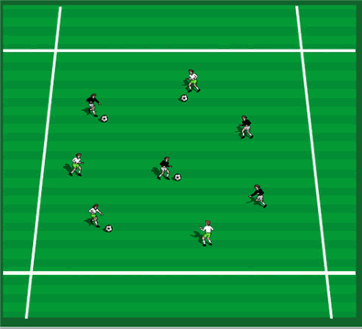
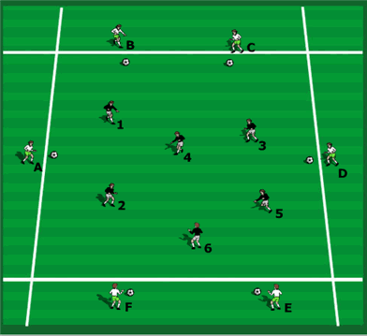
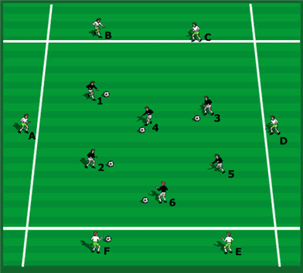
Why is developing Soccer Awareness Important?
A two-team set up
1
2
3
This practice is designed to allow the players to be gently introduced to the fundamentals of the AWARENESS COACHING METHOD enabling them to practice in a more dynamic way. They can move anywhere in the area now.
A two-team set up identifying options
Coaching Points: a) Head up (awareness of the area and the players in it). b) Looking before receiving to receive and turn; to see who is free, to see where other players are, to see where the space is to take the ball. c) Body position open to receive, d) Focus on the first touch and where to take the ball; decide BEFORE receiving the whether it is best to use the first touch for a pass or to set up the next touch.
Soccer Awareness training teaches the players to assess their options BEFORE THEY RECEIVE THE BALL. So, they are always looking ahead of the ball assessing what could happen next. It speeds up their thinking, movement, positioning, decision making to cope with the faster game we experience today.
Awareness concept introduction on the ball using few touches using a one and two touch maximum (example)
1. Use one or two balls per team for passing and moving (or more). You can keep it interesting by changing the theme for each awareness clinic e.g., passing to feet or space, opposite colors, receiving and turning, one touch / two touch, 1-2’s, crossovers etc. 2. This workout is game specific and should be used before actual games.
3. Competitive: Have each player count the number of successful passes he makes in a given time and see who makes the most. Observe and comment on those who try to do it too quickly and lose control of the ball and lose the momentum of the session (for example they rush the pass, it is not accurate, and the receiver ends up running away retrieving the ball which wastes precious time). 4. Change the practice to the balls starting with the inside players. These players now look to pass and receive a give and go from an outside player. 5. Rotate the players so both teams have the chance to play in the middle of the grid. 6. Move both teams to the middle; divide the grid into two with each team passing to their own team within their own grid area, keeping teams separate to begin.

Slide 47
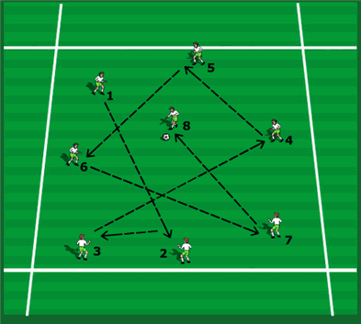
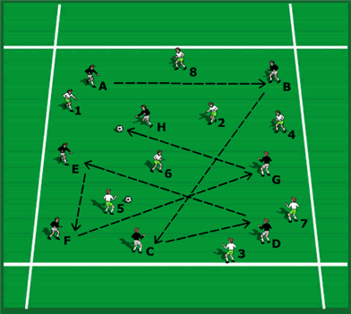
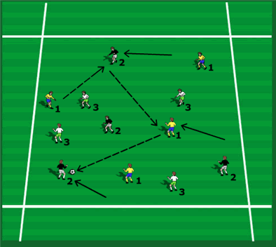
Using a Non – Competitive NUMBERS “Game” with teams passing in sequence to improve awareness on and off the ball
INTRODUCE ANOTHER TEAM TO THE SAME ZONE
1
2
3
30 x 30
1. Two Teams: 6 Players and only 1 ball to begin. Players must pass in sequence i.e., 1 passes to 2; 2 passes to 3; 3 to 4 and so on to 6 who passes to 1 and we begin again. You can have players static to begin then have them passing and moving.
2. Player receives from the same person and passes to the same person each time. This develops great awareness of time, space and player positions. There is continuous work on and off the ball.
3. Awareness of: where the player you receive from is and where the player you pass to is. Because of this players begin to anticipate the pass to them and where it is coming from. Also, they must look to where it is going to (where is the player they are passing to?).
1. The team above can be brought into the same zone to work in as the first team, each with a ball.
2. Coaching Points: a) Awareness of where the player to receive from is before receiving the pass b) Getting into position to help the passer make a successful pass c) Awareness of where the player to pass to is before receiving the pass d) Open Body position to receive the pass to enable a resulting one touch pass if necessary
1. You can begin with two teams in the bigger zone (combined zones of each team) and then have them play in the one zone where it’s tight and more difficult to work in.
2. Obviously, the players move but for simplicity of explanation I have shown it this way.
3. Player (A) is ready to begin the passing of the letters team.
4. Competitive: One ball per team, have a player count the number of passes a “team” makes in a given time period.

Slide 48
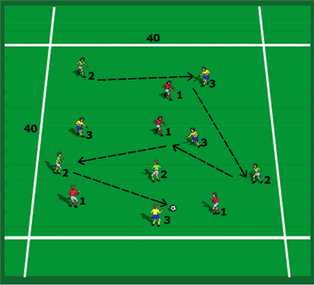
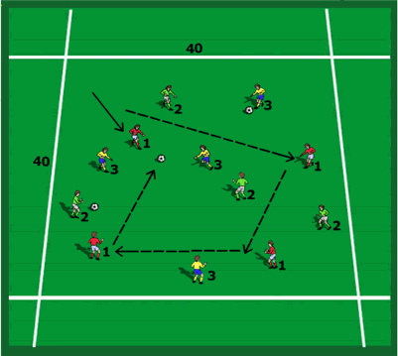
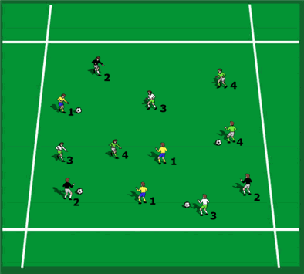
Using a Competitive NUMBERS “game” with teams passing in sequence to improve awareness on and off the ball
COMPETITIVE NON-DIRECTIONAL THREE TEAM AWARENESS POSSESSION GAME (4 v 4 v 4)
1
2
3
1. Further Development: Making it more competitive, have each team be the defending team for a certain time span. If they win the ball; they then give it back to the combined attacking teams. Count the number of times they win the ball. The defending team to win the ball the most times wins the game, or alternatively the combined teams which give up the ball the fewest times win the game.
2. Attacking players individually count the number of times they give the ball away as an indication to every one of them how well they can maintain possession under pressure. Begin with players able to have as many touches as they like, then break it down to 3 touch, then 2 touch with one touch passing the aim if it is on to do so.
1. Conditioning the players to pass and move by setting the rule they need to move into another area once they have passed.
2. Divide the field up into sixth’s and then have the players make a pass in one area then they must move to another area to receive the next pass. This can cause players to pass long or pass short and vary the range and distance of the passes and the support as they are required to move once they have made their pass.
3. Here we are using three teams of four players.
4. Here players pass and move into other zones to receive the next ball that is coming. This ensures players get the idea of passing and MOVING off the ball, not passing and then standing.
5. Can say players must pass to space so they pass into another zone next to the one the player they are passing to in order to force them to move to the ball.
3. Coaching Points: a) Open body stance to allow a yard or more extra space away from defenders by letting the ball run across the body into preconceived space. b) Looking before receiving to know in advance of the receiving pass; where the defending
players are, where the space is, where teammates are free to receive a pass, how many options there are to move the ball on c) Movement OFF the ball is a priority both to receive it and after passing it.

Slide 49
Grades Seven to Nine
A North Star F.C. Training Plan for Recreational Soccer (Week Eight)

Slide 50
Week 8:
Warmup / Foundations
1. Fast Footwork; co-ordination and speed work
a) Getting the feet and body balanced and prepared for the first touch. b) Players must be light on their feet to be able to change their stride patterns, change direction and so on. 5 mins
I thought it would be fun for you to do an 11 v 11 game if its viable with the numbers?
2. One / Two Word Team Shape Commands
Moving a team around the field with one / two-word commands; I have always liked this. It is simple and very clear to understand communication that EVERY player instantly knows what they need to do.
One way to do this is to have them do the command then when the distance needed is reached have them sit down and then look at their shape to see if they maintained it. 10 Mins
3. Playing the 11 a side game
a) I sent out the short version of the basic set up of the 11 v 11 playing 1-4-4-2 so I can elaborate on that again a bit here. 15 Mins
4. Now showing attacking and defending team shape ideas for 1-4-4-2 in Animation
We show the starting position of the team.
Now the attacking team shape.
Then the defending team shape both high up and dropping off.
Then showing how we can counterattack taking the team from defending to attacking. 30 Mins

Slide 51
Warmup
Fast footwork warm up to help speed; co-ordination and balance.
Fast footwork; co-ordination and speed work:
All training is specific to match play. Our work is based upon developing a balance between ball handling and functional running and sprinting in combination with jumping, stopping, and turning.
Quick feet, light feet, changing stride length exercises (short and sharp the best) will be particularly important.
For getting your feet ready to shoot at goal, perhaps with very little time to adjust this exercise is perfect to develop this ability for finishing.
Players can move anywhere. This involves them using anticipation, decision making, reaction and perception and well as co-ordination and fast feet to find space to move without bumping into people.
Peripheral vision development is starting to be introduced without the ball.
Usual coach commands can be start and stop so they are practicing acceleration, deceleration, and lateral movement all in one exercise.
You can also use the commands turn, jump (for a header) check, sit down and so on for which they must do a short sprint after the command then stop on the call stop. All these are specific movements in the game.

Slide 52




One-Word Commands teaching team shape and movement: Applies equally to 7 v 7; 9 v 9 and 11 v 11.
Teaching teams to maintain their team shape and spacing in various scenarios on the field to AID quick Communication.
To get FAST information to the TEAM; and at the same time NOT DISTRACT INDIVIDUALS with directions from the sideline.
Particularly GOOD for Younger teams; may need the COACH to call the words initially.
The momentum is triggered from the back and runs forward through the team to midfield to the strikers. Older teams can have a defender calling the words to dictate what he needs the team to do but better still may be the keeper.
We would like teams to try this in training and use in the game; it is simple but VERY EFFECTIVE. Playing a 1-4-3-1-2 here. Could be any system.
Hence the back players (and the keeper) can organize their movement as a unit (therefore influence the WHOLE TEAM) with FOUR ONE-WORD commands.
Begin WITHOUT a ball in training. Coach calls the words initially, players move accordingly. Add players around the field to pass to; add a ball (slide example), your team move as the ball travels.
Communication must be FAST and IN ADVANCE / ANTICIPATION not a REACTION.
1
UP
Game Situation: UP
1. The Opponents have the ball and pass it back towards their own goal, or we pass the ball forward. 2. Players from the back move up the field only up to perhaps five yards in distance (it may be only one or two yards),.
3. Units move up together maintaining the same distance between each other.
4. They move up a short distance then reassess the situation (and reorganize) depending on where the ball is and who has it.
3
DROP
Game Situation: DROP 1. They have the ball / Moving forward with it. 2. We drop back together recovering back to the goal. NOT all black and white; a situation; they have possession moving forward; NO pressure on the ball so can pass forward in behind our back players for their strikers to run onto. 3. To avoid this, we drop back as a team behind the ball well in ADVANCE of the delivery. 4. Attention to detail: Opponent on the ball facing forward; a) Player on Ball: Head Up: And hence can see a forward run and play the ball in quickly and therefore the back four must drop. or: b) Player on Ball: Head Down: And facing forward but do not see a potential run & therefore delay the forward pass long enough for us to DROP in ANTICIPATION. Plus, our closest player also delaying the forward pass applying pressure; to allow more time to drop & cover.
2
OUT
Game Situation: OUT
1. We have the ball and have played it forward into the attacking third and kept possession (or not, just played it behind the opponent’s defense to create time to get out. 2. The team sprints out together on the OUT word.
3. Distance varies based on the ball, and who has it; it could be 10 to 30 yards sprint; or even more. 4. Leave opponents offside.
4
SLIDE
Game Situation: SLIDE (RIGHT OR LEFT)
1. Here the opposition has played the ball into a very wide area, and we all move across the field.
2. Slide can ALSO be used when the opponents are taking a goal kick, so we have players around the area where the ball is to be kicked. 3. Moving across the field, don’t take it literally at 90 degrees it could be diagonally in a game (45 above) but for our practice you could have them moving across the field like this just to get the idea across. 4. In the game the ball may have been passed wide in the opponent’s possession, and we move across the field as a team to close all the spaces around the ball to try to win it back.

Slide 53

The Basic Defending and Attacking Phases of Play: Team Shape Development in 11 v 11
At these ages team formation is Just a starting point for your team.
So, if you want to at least have a starting position; you can set them up like this in your preferred way.
No one way is necessarily better than another it depends on your own preference, but some are easier than others to initially teach.
A simplest introduction to playing 11 v 11 in street soccer is using the 1-4-4-2 team shape.
It is a very easy and simple “transition” from a defensive 1-4-4-2 to an attacking 1-4-2-4 using cones as reference points for players to best find their positions.
Over the weeks training and in games you can perhaps try different formations, but we would recommend staying with this team shape for now.
Don’t expect your players to grasp this immediately it all takes time and patience; overall let them play and have a lot of Fun.
Do encourage your players to move higher up the field in possession “as a team” from the back defensive line, don’t have big gaps between each unit / line of players (see slides 5 and 6).
Using Cones to identify positions is a very easy but effective way to show players team shape, try it in training.
This shown is the usual formation set up that we would recommend but use your own ideas too.

Slide 54
Formation: 11 vs. 11 = 1 - 4 - 4 - 2
GK = Goalkeeper
Defenders:
RB = Right Back
LB = Left Back
LCB = Left Central Defender
RCB = Right Central Defender
Midfielders:
LCM = Left Center Midfielder
RCM = Right Center Midfielder
WRM = Wide Right Midfielder
WLM = Wide Left Midfielder
Forwards:
ST = Left Striker
ST = Right Striker
The 4-4-2 flat is a football formation that uses a flat midfield, and is made up of four defenders, four midfielders, and two strikers.
Here are some things to know about the 4-4-2 flat:
Basic Strengths: The 4-4-2 flat can create a strong double defense wall, and the fullbacks and midfielders can put pressure on the sidelines.
Basic Weaknesses: The 4-4-2 flat can be outnumbered in central if the opposition has three or more players in their midfield.
The gap between the midfield and attack can also be exploited by the opposition.
Popularity: The 4-4-2 has seen a resurgence among teams that want to contain their opponents.
LB
WLM
3
11
LCB
LCM
LS
GK
5
6
10
1
RCM
RS
RCB
8
9
4
RB
WRM
2
7

Slide 55

Team shape from a defending 1-4-4-2 to an attacking 1-4-2-4
Cones are for reference points only.
This is a really easy way to teach team shape for your teams.
As we advance up the field, we want to try to creates overloads in possession in the opponents defending third, this shows some ways to do it.
Red cones defensive team positioning.
Yellow cones attacking team positioning.
Phase One
3
11
5
10
8
1
9
4
6
2
7
Defensive shape is at the red triangular cones. Attacking shape at yellow triangular cones.

Slide 56
Team shape attacking from a defensive 1-4-4-2 to an attacking 1-4-2-4
Phase Two
3
11
Defending we are a 1-4-4-2
Attacking we are a 1-4-2-4.
This means an easy transition between defending and attacking with the two fullback’s and two wide midfield players pushing on to become wingers.
So, we are very solid defensively doing it this way.
6
10
5
1
4
9
8
2
7
Defensive shape is at the red triangular cones. Attacking shape at the yellow triangular cones.

Slide 57
Movement UP the field “as a team” in Possession
3
11
5
6
10
1
4
8
9
2
7
Please try to avoid this situation where you have your back four players and your keeper not moving forward as a team. Firstly, it means if you lose possession there is a massive space Infront of the back line to play into for your opponents to attack, and secondly your back line and keeper are far less involved in the game. So; the back line and keeper must push up the same as the rest of the team does.

Slide 58
Back four line is too deep opponents win possession
11
A
3
H
When you are in attack, if your back four line and your keeper stay deep like this then you are essentially playing down numbers; in this case it is a 6 v 11 against us.
F
5
6
10
B
1
I
E
8
4
9
C
J
G
2
7
D
Please try to avoid this situation where you have your back four players and your keeper not moving forward as a team. We lose possession and now opponents exploit the BIG SPACE between the two lines where it is now too easy to keep possession; and we are in trouble..

Slide 59
Defending HIGHER up the field pushes opponents back and further away from our goal.
Do not forget the KEEPER must play higher up the field too then he / she becomes an extra player in the field for you and covers the defensive back line.
Too often we see the keeper still on the goal line which takes them completely out of the game.
Opponents play 1-4-3-3.
11
3
A
H
F
5
10
6
B
1
I
E
4
8
C
G
9
2
J
D
7
Opponents (front three) could be offside so they must drop back. Do this and it will make a massive difference to how it helps you keep possession or regain it if you lost it; with very little space for opponents between the lines..

Slide 60
Team Shape & Tactical development for 11 v 11 and 1-4-4-2.
Presented in an Animation format.

Slide 61
Team Shape development broken down to 5 Phases of Play
Tactical Team Shape is often determined by a team's attacking shape and defending shape.
I have tried to simply the process of this by putting it into 5 Phases of action.
Phase One: Defending Team Shape
Phase Two: Attacking Team Shape
Phase Three: Overloading players in Zone 14
Phase Four: Interchanging and rotating player positions in Zone 14 and the Attacking Third
Phase Five: Defensive Pressing Team Shape in the Attacking Third.
Here we discuss these 5 phases for 11 v 11.
These are suggestions only; and JUST ONE way to teach it.
Phases three and four need a good deal of time to teach so we will look
at Phases 1, 2 and 5 only here. If you would like to see it all then let me know.

Slide 62
Animation
Distribution from the back possibilities: A goal kick set up to play out the back
Phase One
This is the start position
3
G
11
Zone 14
5
D
Zone 14
J
10
C
I
F
9
6
K
B
8
A
4
H
E
7
2
1-4-4-2 (Defensive Team Shape). Opponents cannot encroach into the box.

Slide 63
If we must go Long: Getting it right: We push up and tuck in get compact as a team, then the keeper kicks it long
Looking to win the 2nd ball in the attacking third
Keeper WAITS until we are pushed up higher.
Support in front of and behind (9)
3
11
Opponents press HIGH and STOP us building out from the back.
Support off the ball for a flick on behind the defense and here it’s (7) and (11).
AND if opponent wins the header then support In front of (9) for the clearance,
(9) Must put in a strong challenge to make it a difficult header and clearance for defender (C).
Here it’s (3), (8) and (10) supporting in front of (9) to win the second ball.
Opponents up front will likely drop back but also likely wont do it as fast as we push up.
D
G
Zone 14
5
J
10
C
F
I
9
B
6
8
A
E
4
H
2
7
Opponents press HIGH so we push out we leave them offside, and we congregate around (9) to where the ball is going.

Slide 64
Phase Two (1-4-4-2)
We haven't shown defenders dropping off as they invariably would to enable the clarity of the attacking movements to be seen.

Slide 65
Animation
Build-up from the back in free play: Maybe more offensive pushing (9) and (10) higher initially
Phase Two
D
J
G
Zone 14
3
11
5
6
C
10
I
F
8
4
9
B
E
2
7
H
A
Defensive team shape 1-4-4-2 (condensed) to an Attacking team shape now

Slide 66
Another way to Build out the back: We push out, the opposition follow and mark us
Animation
Phase Two Beginning
D
3
J
G
Zone 14
11
10
C
5
6
I
F
4
9
8
B
H
E
2
7
A
Defensive team shape 1-4-4-2 (condensed) to an Attacking team shape

Slide 67
We have cleared space behind and now drop in very quickly before opponents can react
Animation
Phase Two Beginning
3
J
D
11
G
Zone 14
5
6
10
C
I
F
4
9
B
8
E
H
7
A
2
Likely won't be all the back four but this is an example of what might happen

Slide 68
Phase Five
Defensive Phase

Slide 69
Pressing High and forcing INSIDE to win the ball
Animation
Phase Five Press
G
3
11
D
j
Zone 14
5
10
C
I
F
6
9
8
4
B
H
E
A
7
2
Leaving opponents offside
We have lost possession and ARE able to press immediately: Try to show INSIDE to our defensive support

Slide 70
Recovery Runs of the team from Attacking to Defending team shape
Animation
Phase Five Drop Off
J
D
3
11
G
Zone 14
5
C
10
I
6
F
9
B
4
E
A
H
8
2
7
We have lost possession and are not able to press immediately

Slide 71
More realistic showing opponent dropping back also as they would
Animation
Phase Five Defend deep and Counterattack
D
Zone 14
3
j
G
11
5
C
I
10
6
F
8
4
9
H
B
E
2
7
A
We have won the ball and counter Quickly: If winning we might be cautious with wing backs attacking too

